Slide 1
Data Science Project
Coursera Capstone
Deepak Singh

Slide 2
Report Content
1. Introduction Section :
⁃ The “business problem”
2. Data Section:
to be solved by this project and who may be interested
⁃ Describe Data requirements and Sources needed to solve the problem
3. Methodology section:
⁃ Main component of the report - Execute data processing, describe/discuss any
exploratory data analysis and/or inferential statistical testing performed, and/or machine learnings used.
4. Results section:
⁃ Discussion of the results and finding of answer
5. Discussion section:
⁃ Discussion of observations noted and any recommendations
6. Conclusion section:
⁃ Answer chosen and conclusions.

Slide 3
1.0 Introduction
Discussion of the business problem and the audience who would be interested in this project.
Description of the Problem and Background
Scenario:
I am a data scientist residing in Downtown Los Angeles.
I currently live within walking distance to Downtown metro station and I enjoy many amenities and venues in the area, such as various international cousins restaurants, cafes, food shops and entertainment.
I have been offered a great opportunity to work for a leader firm in Manhattan, NY. I am very excited and I want to use this opportunity to practice my learning in Coursera in order to answer relevant questions arisen. The key question is

Slide 4
How can I find a convenient and enjoyable place similar to mine now in Los Angeles?
Certainly, I can use available real estate apps and Google but the idea is to use and apply myself the learned tools during the course.
In order to make a comparison and evaluation of the rental options in Manhattan NY, I must set some basis, therefore the apartment in Manhattan must meet the following demands:
1. Apartment must be 2 or 3 bedrooms
2. desired location is near a metro station in the Manhattan area and within 1.0 mile (1.6 km) radius
3. price of rent not exceed 7000 dollars per month
4. Top amenities in the selected neighborhood shall be similar to current residence.
5. Desirable to have venues such as coffee shops, restaurants Asian Thai, wine stores, gym and food.

Slide 5
2.0 Data Section
2.1 Data Requirements
Geodata for current residence in Singapore with venues established using Foursquare.
List of Manhattan (MH) neighborhoods with clustered venues established via Foursquare (as Lab). https://en.wikipedia.org/wiki/List_of_Manhattan_neighborhoods#Midtown_neighborho
List of subway metro stations in Manhattan with addresses and geo data (lat,long): https:// en.wikipedia.org/wiki/List_of_New_York_City_Subway_stations_in_Manhattan) , (https://www.google.com/ maps/search/manhattan+subway+metro+stations/@40.7837297,-74.1033043,11z/data=!3m1!4b1)
List of apartments for rent in Manhattan area with information on neighborhood location, add beds, area size, monthly rent price and complemented with geo data via Nomination
http:// www.rentmanhattan.com/index.cfm?page=search&state=results

Slide 6
2.2 Data Sources, Data Processing and Tools used
Manhattan neighborhoods were obtained from Wikipedia and organized by Neighborhoods Nomination for mapping with Folium.
List of Subway stations was obtained via Wikipedia, NY Transit web site and Google map,
List of apartments for rent was consolidated from web-scraping real estate sites for Manhattan. The (latitude, longitude) data was found with algorithm coding and using Nomination.

Slide 7
3.0 Methodology
The Strategy to find the answer:
The strategy is based on mapping the described data in section 2.0, in order choice of at least two candidate places for rent. The information will be consol MAP where one can see the details of the apartment, the cluster of venues in and the relative location from a subway station and from work place. A mea will also be provided. The popups on the map items will display rent price, lo cluster of venues applicable.
The Tools:
Web-scraping of sites is used to consolidate data-frame information which files for convenience and to simply the report. Geodata was obtained by coding to use Nominatim to get latitude and longitude of subway stations and also units) the apartments for rent listed. Geopy_distance and Nominatim were used relative distances. Seaborn graphic was used for general statistics on rental dat
Maps with popups labels allow quick identification of location, price and feature, thus making the selection very easy

Slide 8
4.0 Execution and Results

Slide 9
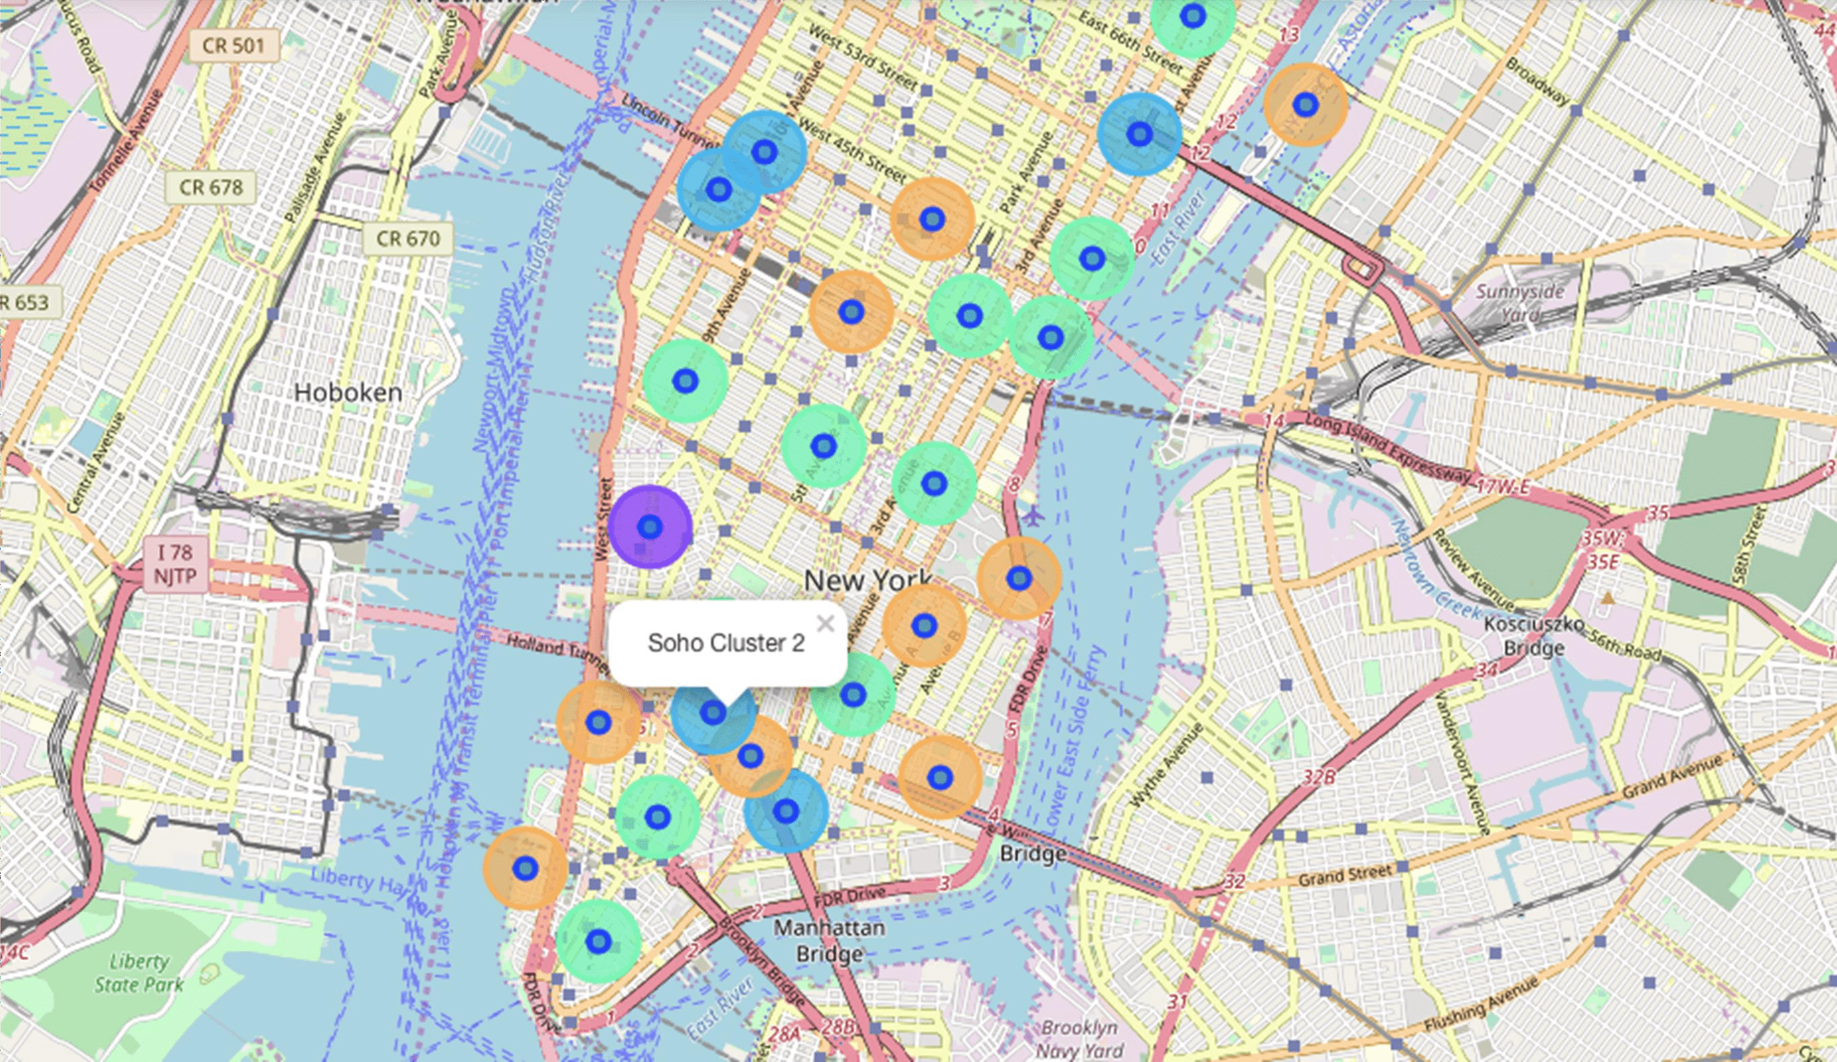
Manhattan Map - Neighborhoods and Cluster of V

Slide 10
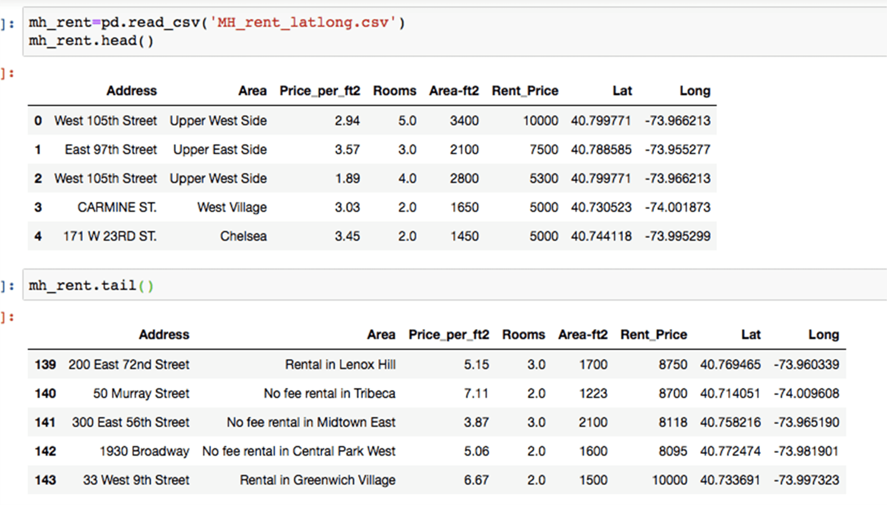
GeoData Manhattan apts for rent

Slide 11
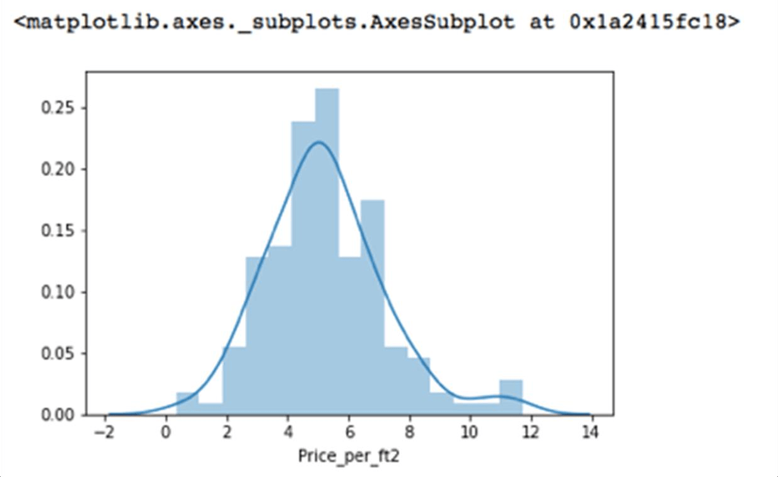
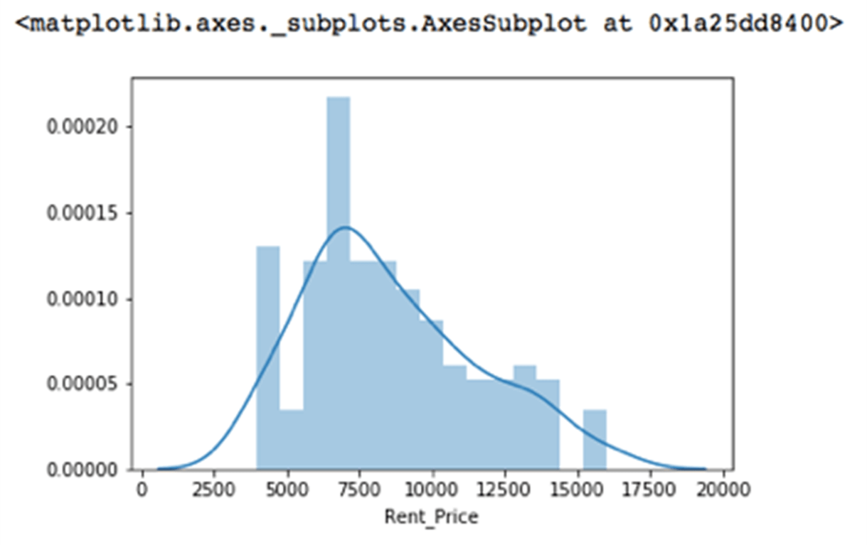
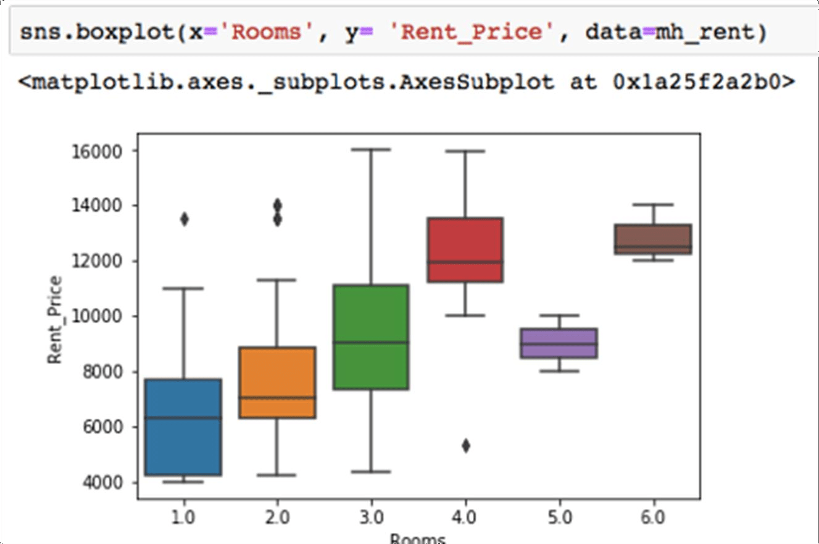
Rental Price Statistics Manhattan Apartments
Budget US7000/month is around the mean

Slide 12
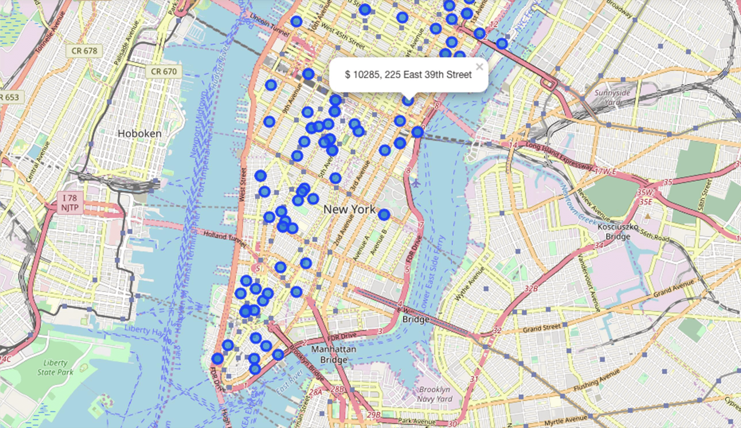
Apartments for Rent in Manhatten

Slide 13
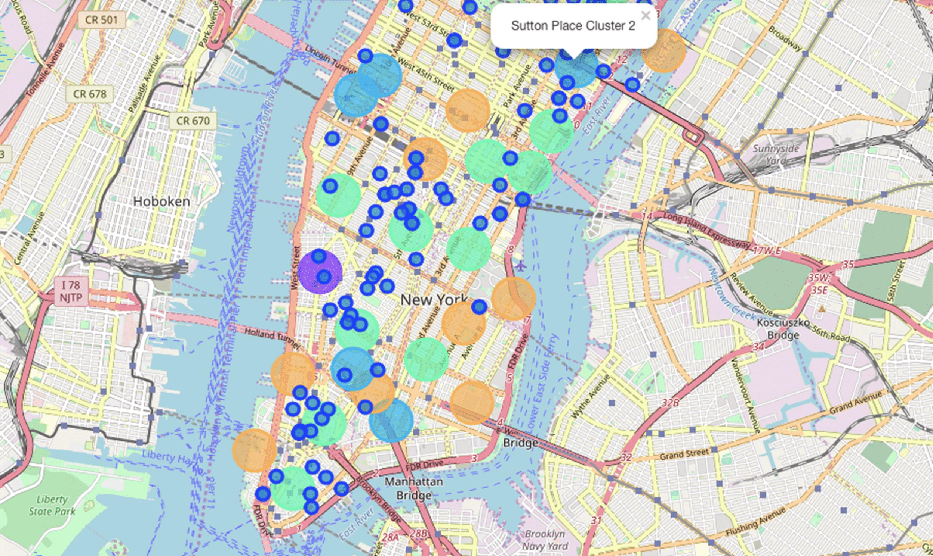
Manhattan apartments for rent with venue cluster

Slide 14
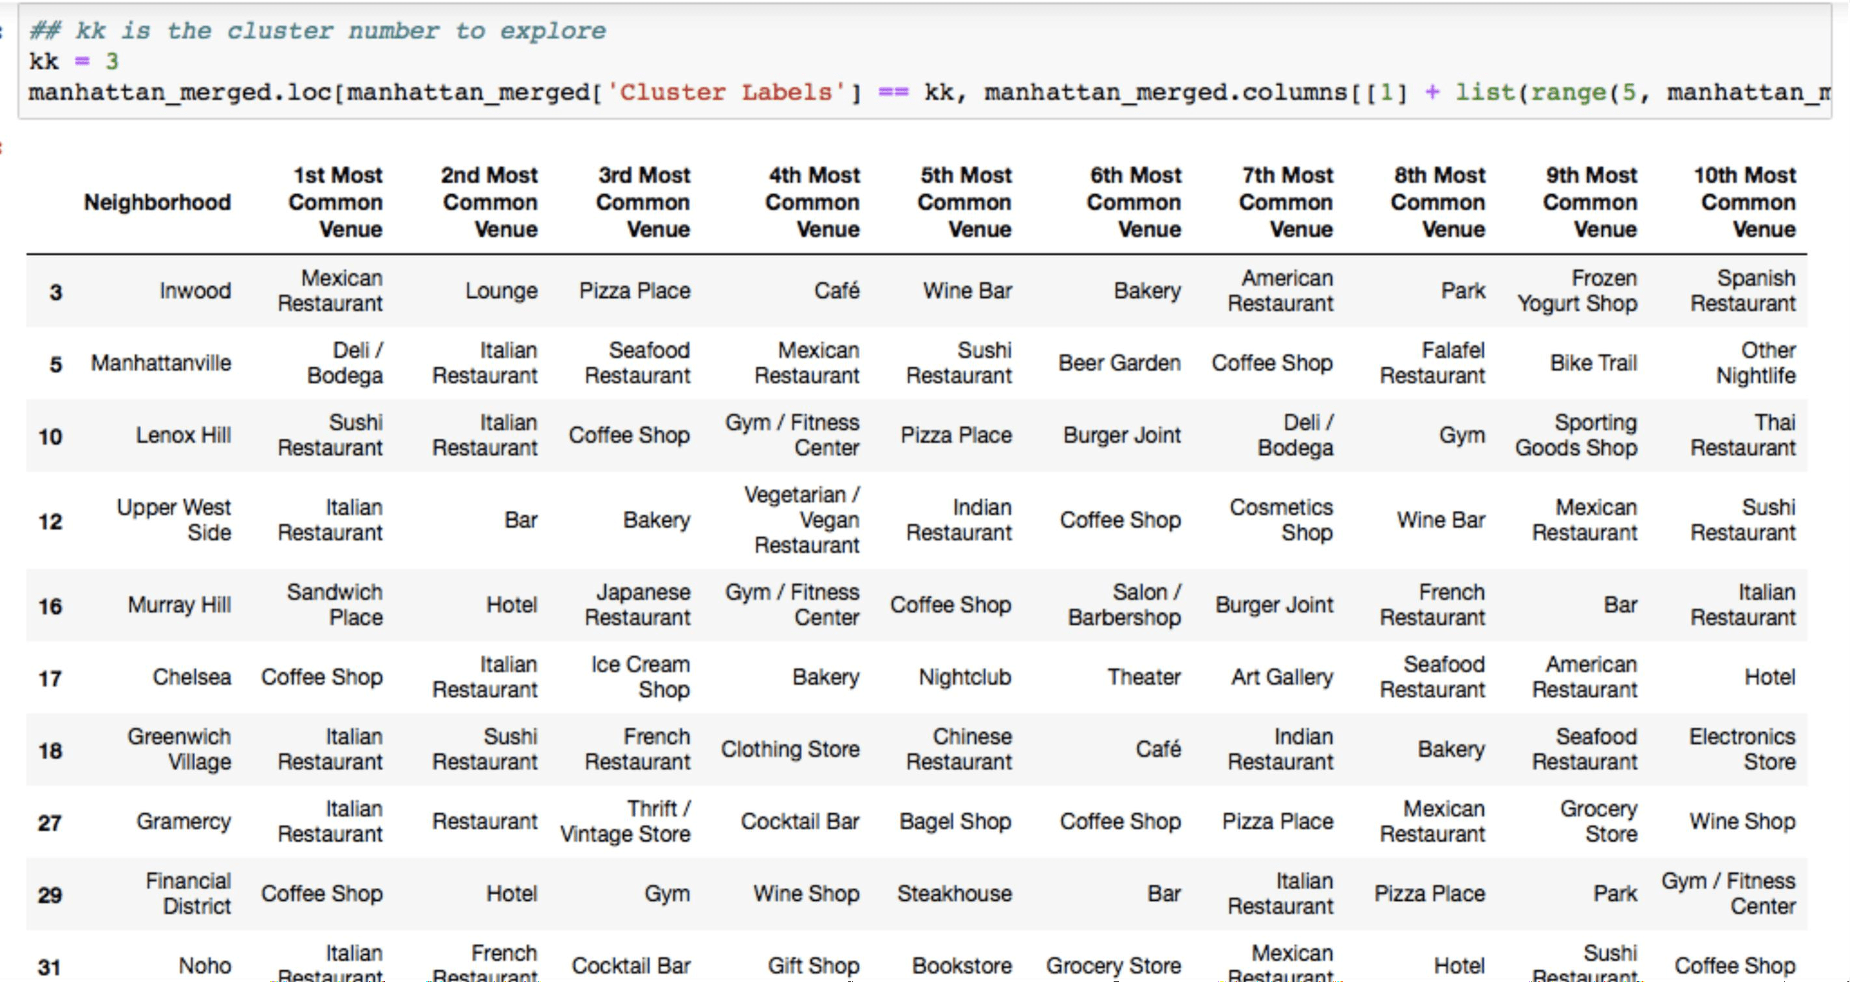
Venues of cluster 3

Slide 15
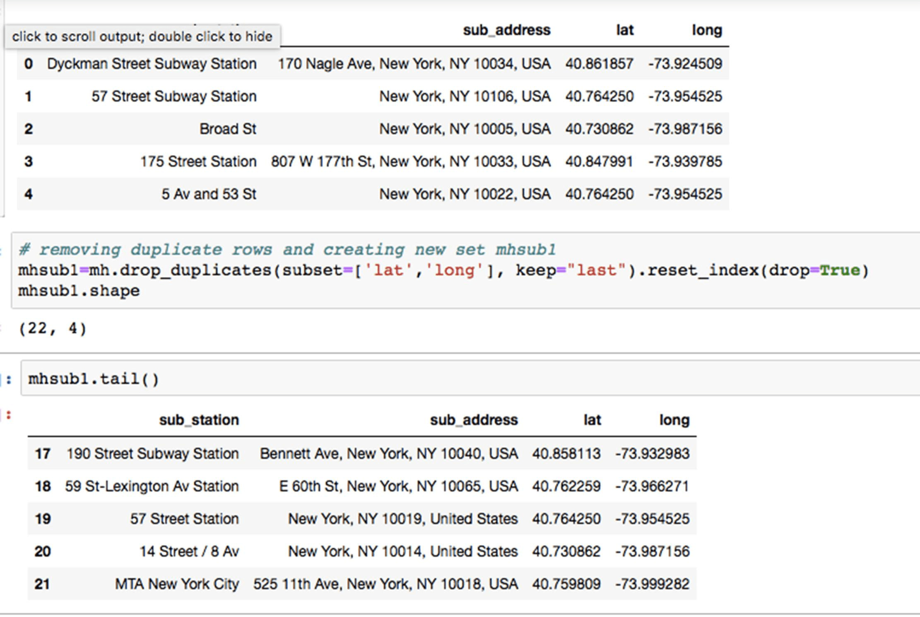
Manhattan subway stations geodata

Slide 16
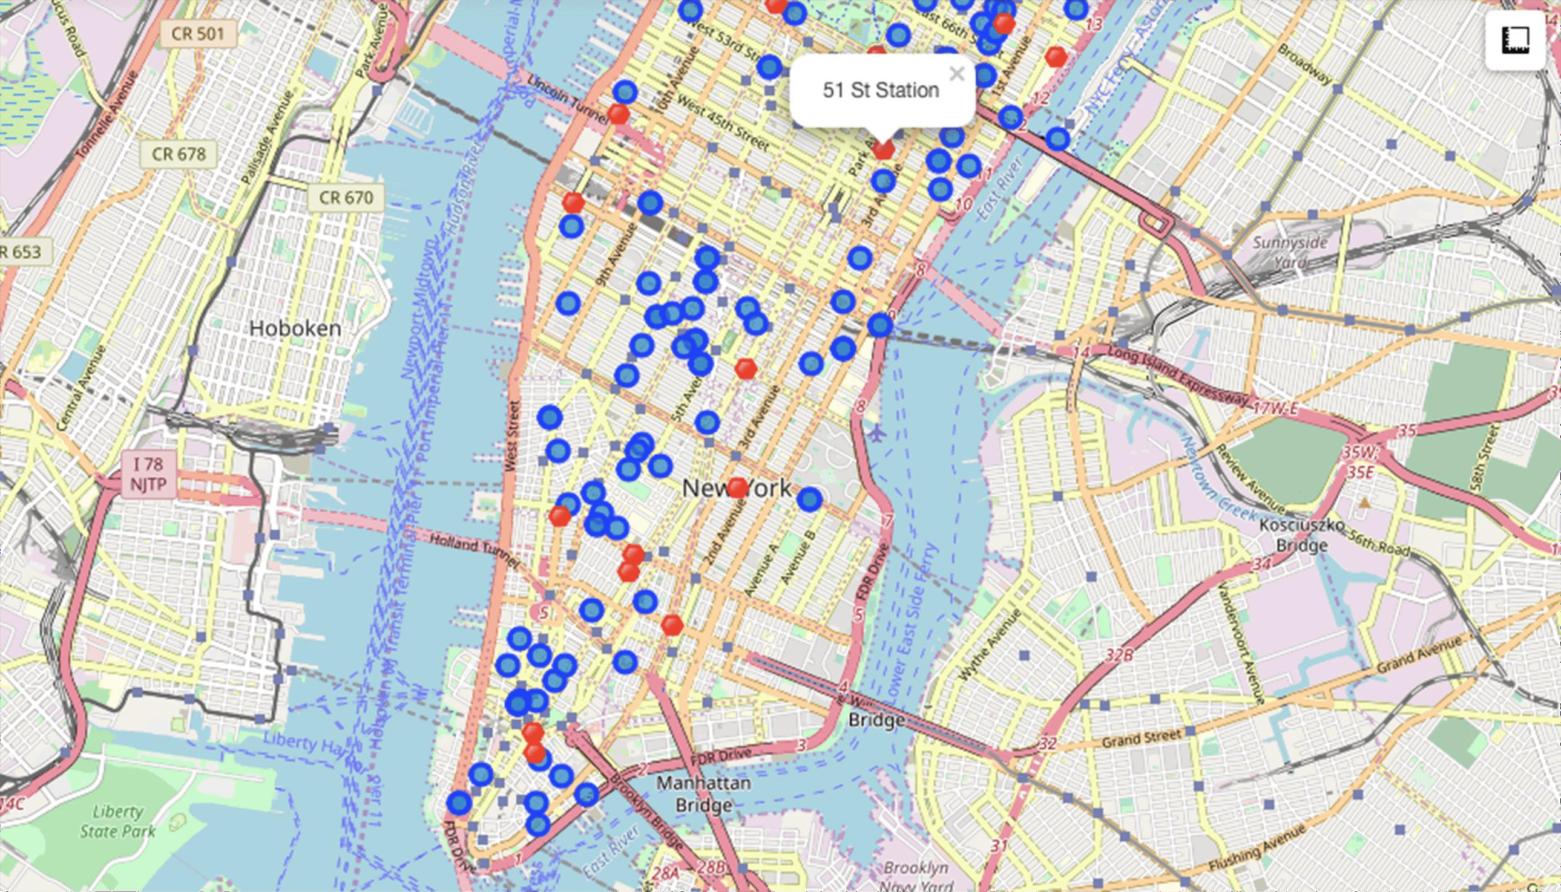
Apts for rent (blue) and subway stations (red)

Slide 17
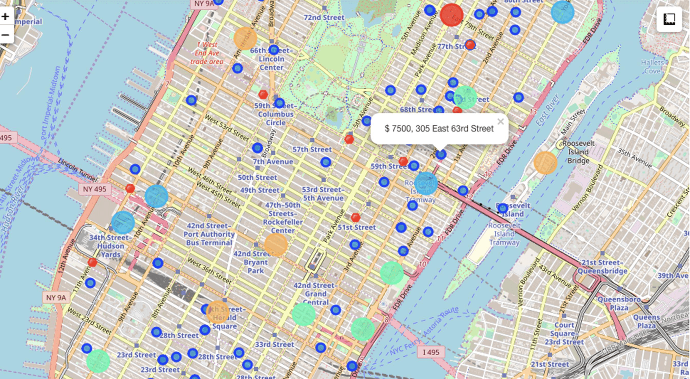
Selected Apartment

Slide 18
Apartment Selection
Using the "one map" above, I was able to explore all possibilities since the the information needed for a good decision.
Apartment 1 rent cost is US7500 slightly above the US7000 budget. Apt 1 400 meters from subway station at 59th Street and work place ( Park Ave and 600 meters way. I can walk to work place and use subway for other places a this apt are as of Cluster 2 and it is located in a fine district in the East side
Apartment 2 rent cost is US6935, just under the US7000 budget. Apt 2 is from subway station at Fulton Street, but I will have to ride the subway dail possibly 40-60 min ride. Venues for this apt are as of Cluster 3.¶
Based on current Singapore venues, I feel that Cluster 2 type of venues is a resemblance to my current place. That means that APARTMENT 1 is a bett

Slide 19
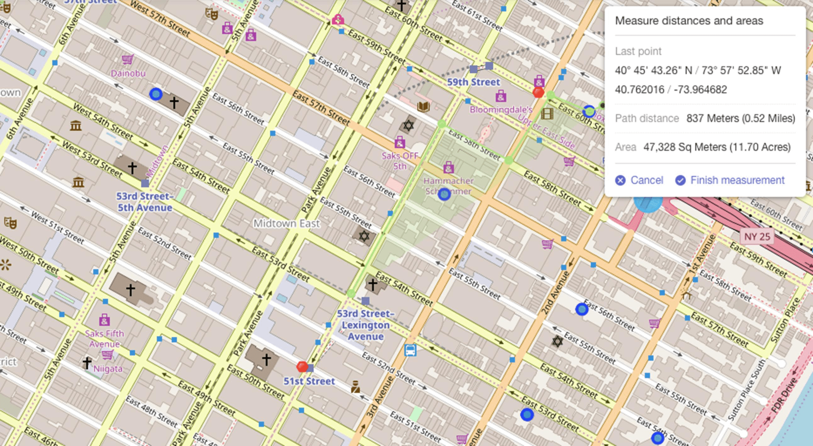
Neighborhood

Slide 20
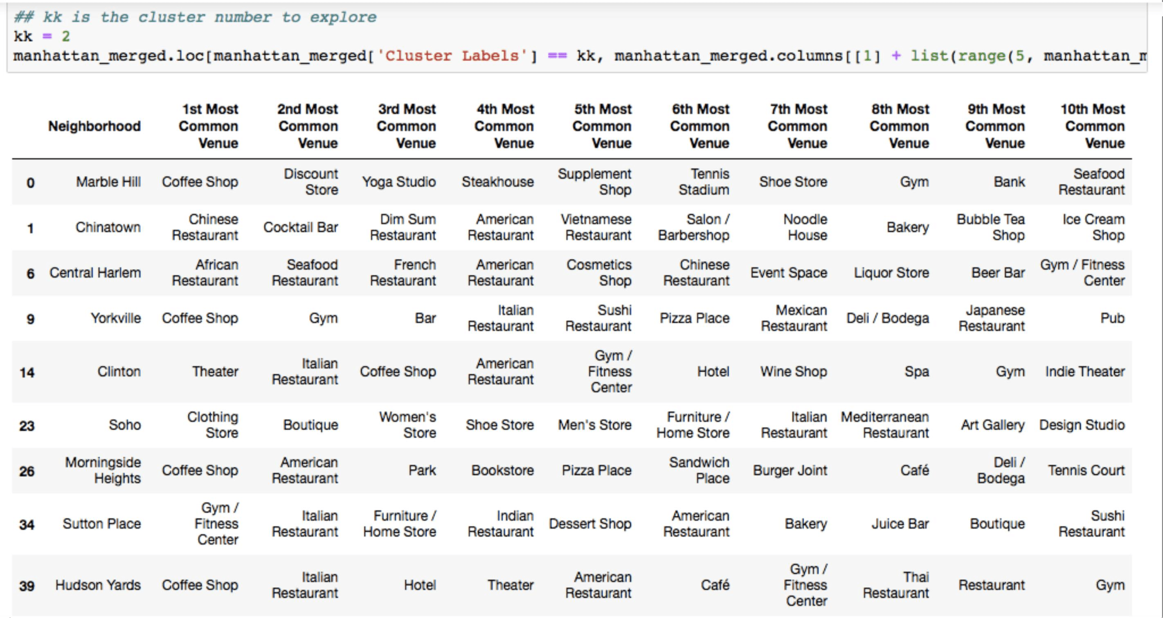
Venus in Cluster 2 near future home

Slide 21
5.0 Discussion
In general, I am positively impressed with the organization, content and lab works presented the Coursera IBM Certification Course
I feel this Capstone project presented me a opportunity to practice and apply the Data tools and methodologies learned.
I have created a good project that I can present example to show my potential.
I feel I have acquired a good starting point to kick start my career again.

Slide 22
6.0 Conclusions
I feel rewarded with the efforts and time, I believe this course with all the topics covered is of appreciation.
This project has shown me a practical application a real situation that has impacting personal and impact using Data Science tools.
The mapping with Folium is a very powerful te consolidate information and make the analysis a thoroughly and with confidence. I would recommend use in similar situations.

